Slide 1

Capstone Project – Phase II Leveraging Landslide Detection For Remote Sensing Images using a Hybrid SAM+SWIN Transformer Model Team Details: Janhavi PG – 2022BCSE07AED495 Anushka Reddy – 2022BCSE07AED639 Shriraj Nandkishor Pardeshi – 2022BCSE07AED633 B Purushotham – 2022BCSE07AED758 Guided by: Dr. A Ezil Sam Leni

Slide 2
Problem Statement
Landslides are a major natural hazard requiring rapid mapping for risk mitigation
Remote sensing-based detection is challenging due to:
Complex terrain and mixed land cover
Lighting and seasonal variations
Limited labelled/annotated datasets
Goal: automated, precise landslide segmentation from satellite imagery
Approach: hybrid SAM + Swin Transformer architecture
Outcome: improved detection accuracy and better generalization across regions

Slide 3
Existing Systems
Traditional ML Methods: Use manually engineered features and classifiers; limited scalability and poor performance in complex and heterogeneous landscapes.
CNN-based Models: Effectively capture local spatial features and textures but struggle with long-range contextual relationships and precise boundary delineation.
Transformer-based Models: Improve global context modeling through attention mechanisms but often face challenges in boundary localization and computational efficiency.
Hybrid CNN–Transformer Models: Combine local and global feature learning and show improved performance, though boundary ambiguity and generalization across regions remain open challenges.

Slide 4
Proposed System
Input: Remote sensing satellite images.
Stage 1 – Region Proposal (SAM): generate region-level masks to isolate candidate landslide areas.
Stage 2 – Feature Learning (Swin Transformer): learn hierarchical representations guided by SAM segments.
Stage 3 – Prediction: produce landslide classification/segmentation output (mask + overlay).
Noise Suppression: reduce background/irrelevant regions using SAM-based masking.
Evaluation: compare Swin-only vs SAM + Swin using IoU, Dice/F1, Precision, Recall.

Slide 5
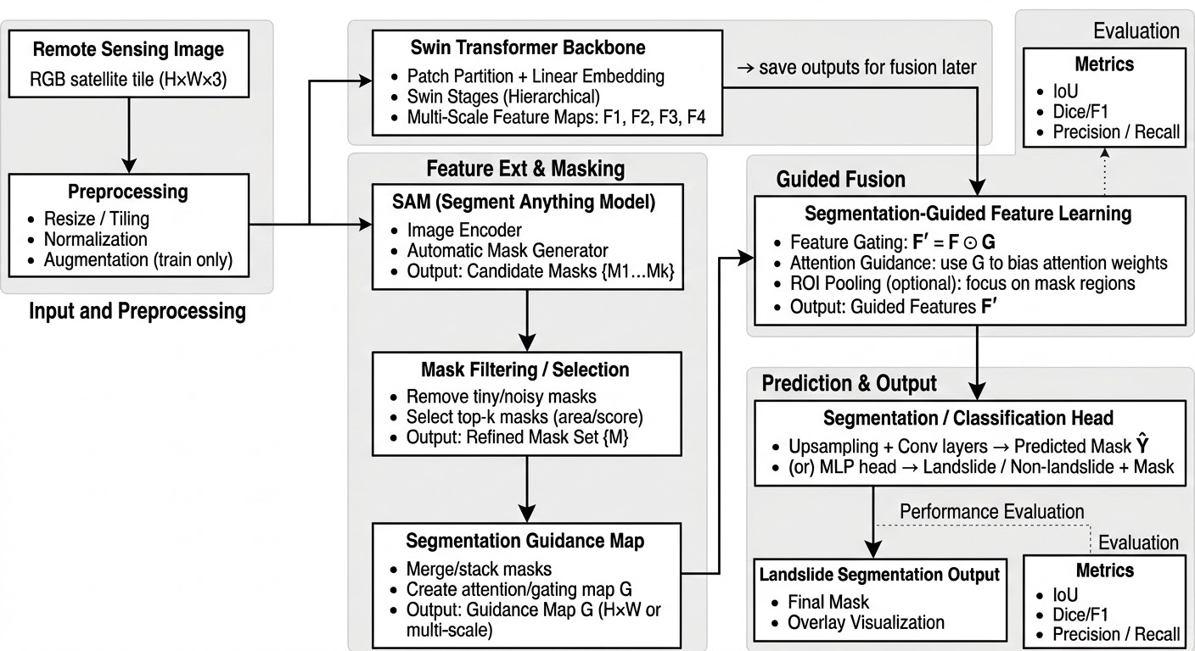
Architecture of the Proposed Work
Input & Preprocessing: satellite image → resize/normalize
Swin Backbone: extracts multi-scale features (F1–F4)
SAM Masks: generates and filters ROI masks
Guided Fusion: ROI masks focus Swin features, suppress background
Segmentation Head: predicts final landslide mask
Metrics: IoU, Dice/F1, Precision, Recall

Slide 6
Technology Stack
Frontend: None (Notebook-based workflow)
Backend: Python (Jupyter Notebook)
Cloud Platform: Kaggle (dataset sourcing)
Tools & Frameworks: Jupyter Notebook, Conda, TensorFlow, Keras, PyTorch, CUDA (GPU)
AI/ML Models: Segment Anything Model (SAM), Swin Transformer, CNN Baseline Models

Slide 7
Key Features
Introduces a segmentation-assisted transformer framework, where region-level segmentation guides feature extraction rather than acting as a standalone output.
Leverages the Segment Anything Model (SAM) to provide spatial priors, which is not commonly explored in existing landslide detection pipelines.
Positions the Swin Transformer as the primary contextual backbone, enabling hierarchical attention over segmentation-guided regions.
Moves beyond conventional CNN–Transformer hybrids by integrating segmentation guidance instead of direct feature fusion.

Slide 8
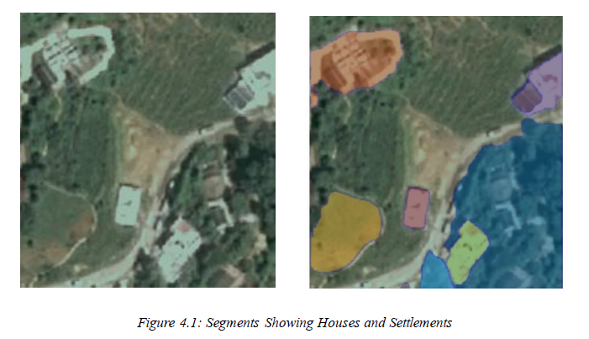
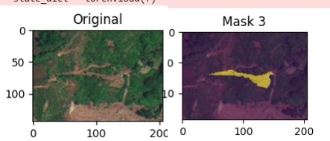
Demo Screenshots
Landslide Region Isolation

Slide 9
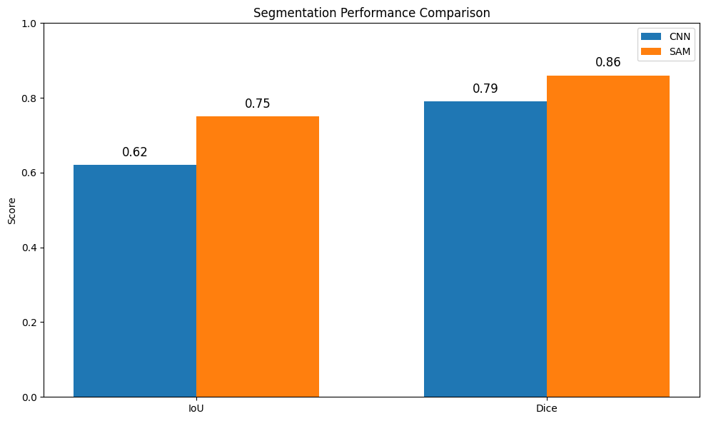
Results-Graph
Performance graphs, charts
Because SAM performs pixel-level segmentation, IoU and Dice directly evaluate mask overlap and boundary quality, which are more meaningful.

Slide 10
Conclusion and Future Scope
Developed a hybrid pipeline combining SAM-based region masks with a Swin Transformer for landslide segmentation in remote sensing images
SAM helps highlight candidate landslide regions and suppress background noise; Swin improves hierarchical feature learning
Comparative evaluation planned/performed against standalone Swin Transformer using IoU, Dice/F1, Precision, Recall
Future Scope 1: expand to larger multi-region datasets and handle domain shifts (season, illumination, sensor differences)
Future Scope 2: explore SAM prompt strategies/fine-tuning + post-processing to reduce false positives
Future Scope 3: optimize inference for scalable/near real-time deployment on large satellite scenes

